Slide 1
Beginning Gardener’s Class
Week 5
24 April 2017
Stephen Janak
County Extension Agent – Agriculture & Natural Resources
Colorado County

Slide 2
Week 4
Wrap-up Insect pests
Trap crops
Attracting beneficials
Understanding Pesticides
Disease management
Common disease problems
Cover crops

Slide 3
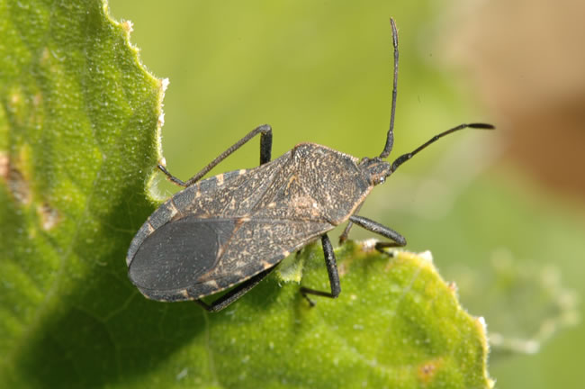
Squash bug!
Like most bugs, it is not specific to only one vegetable
Squash, zucchini, pumpkin, cucumber
Piercing-sucking
Yellow spots that turn brown.
Wilting, crisping, holes, death of leaf.

Slide 4
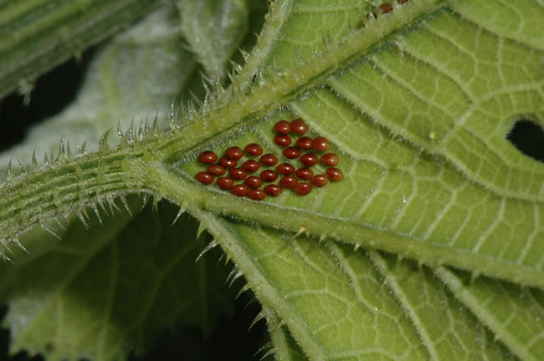
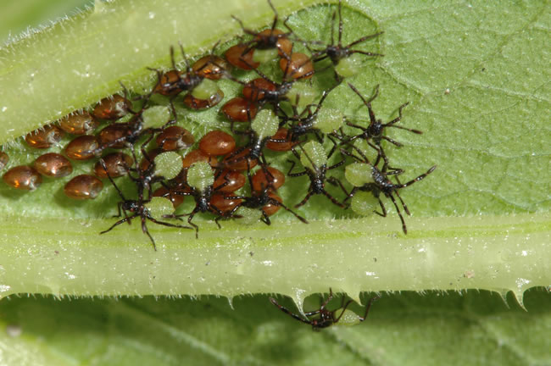
Squash bug
Overwinter as adults in sheltered places: plant debris, buildings, rocks.
Adults emerge in spring, fly to cucurbits, feed and mate.
Eggs are hard to crush.

Slide 5
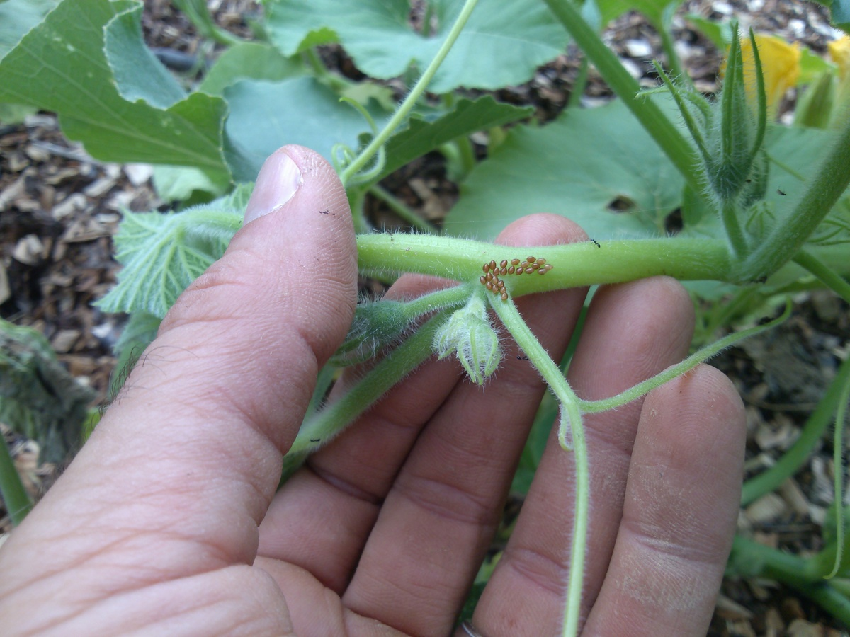
Squash bug
Eggs mostly laid on underside of leaf (common) but also on stems
Eggs hatch in 10 days.
Feed for 6 to 8 weeks to maturity.

Slide 6
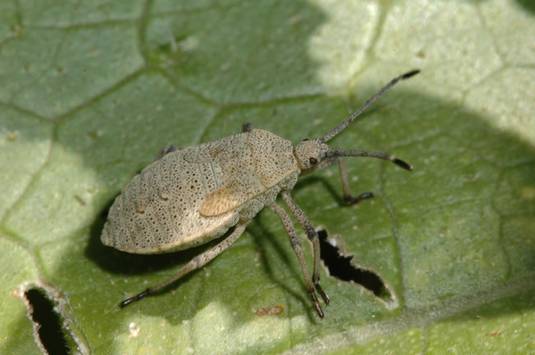
Squash bug

Slide 7
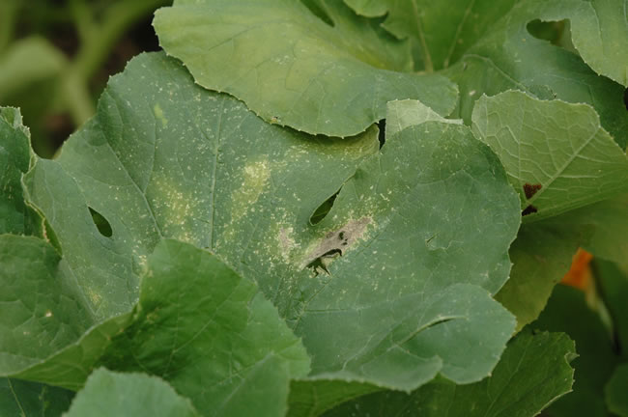
Squash bug

Slide 8
Squash bug
Cultural management:
Crush eggs/nymphs
Provide cover overnight on soil, treat in the morning.
Remove plant debris after harvest to minimize overwintering
Chemical:
Carbaryl (Sevin)
Permethrin
Insecticidal soaps
All products most effective on young nyphms
Focus on underside of the leaves.

Slide 9
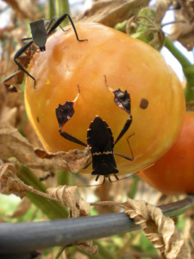
Leaf-footed bug
With stink bugs, these are the toughest to control in the garden.
Early detection is key
Nymphs are always easier to kill.
Does not transmit disease, but open wound susceptible to fungal infection

Slide 10
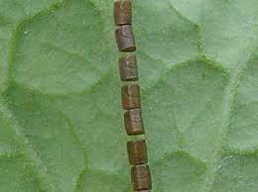
Leaf-footed bug
Destroy eggs

Slide 11
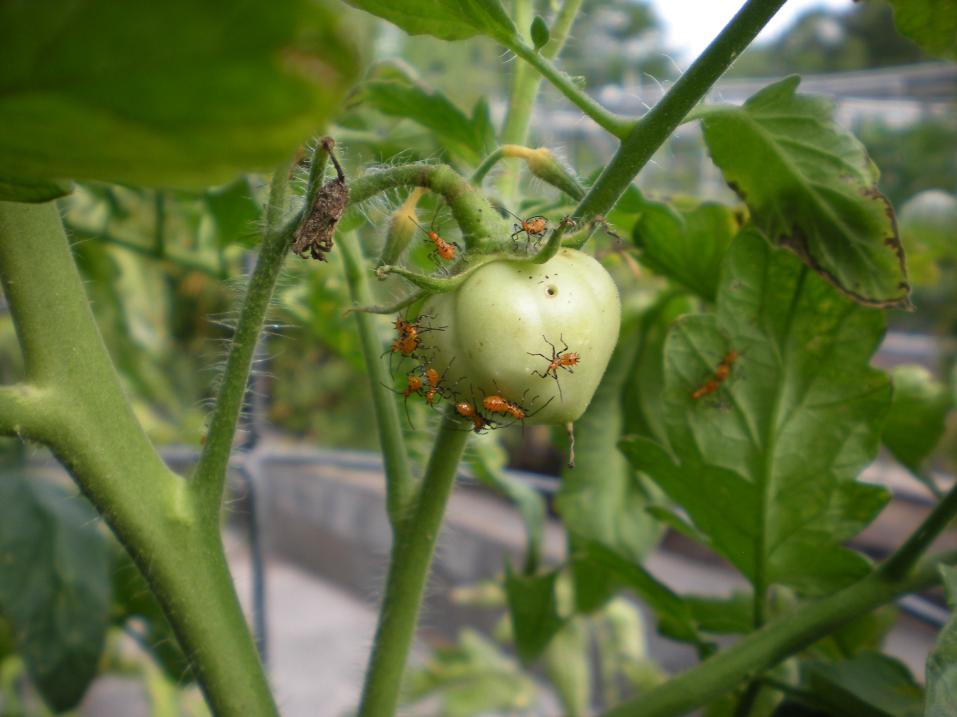
Leaf-footed bug
Nymphs of Leaf-footed bug.

Slide 12
Leaf-footed bug
Crush, vacuum, knock into soapy water.
At early nymph stage, Insecticidal soap, neem oil, pyrethrins may provide some control.
Nymphs often cluster when young, making them easier to kill with targeted applications.
Early morning is best time to find, with less movement.
Pyrethroid insecticides are the only thing that will work on adults, including stink bugs.

Slide 13
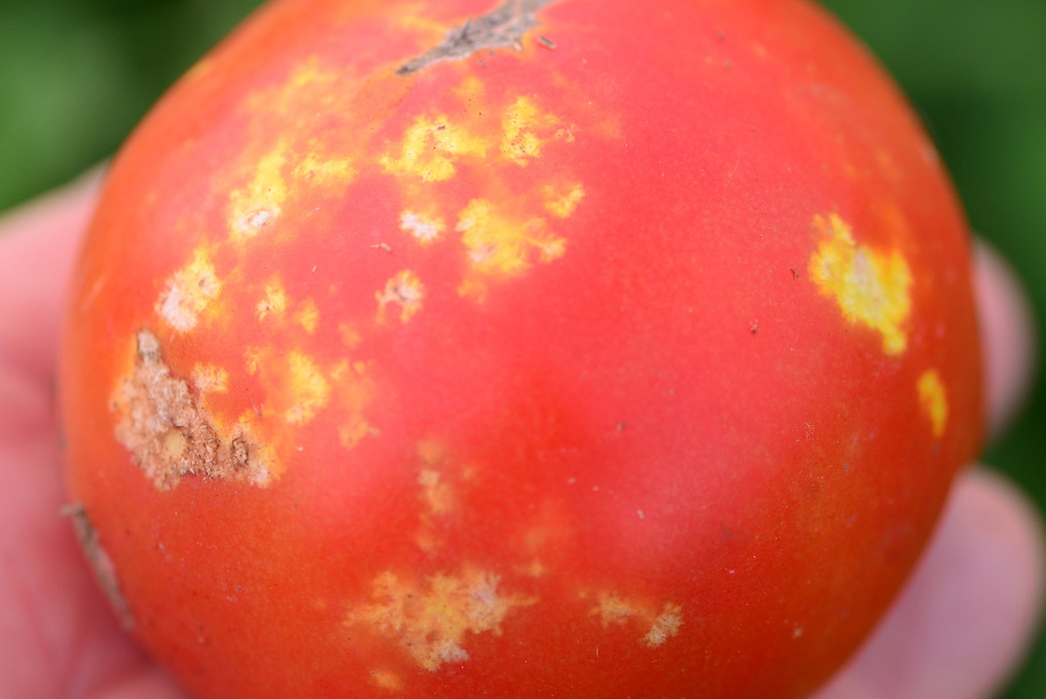
Leaf-footed bug
Feeding on fruit is main source of damage.
Fruit is still completely edible.
Cut away bad parts if desired.

Slide 14
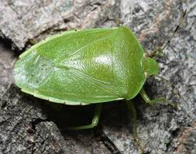
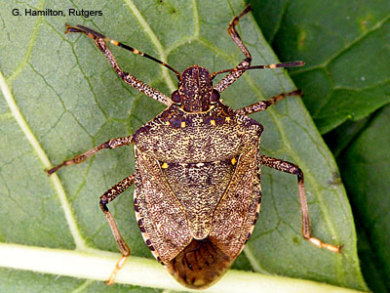
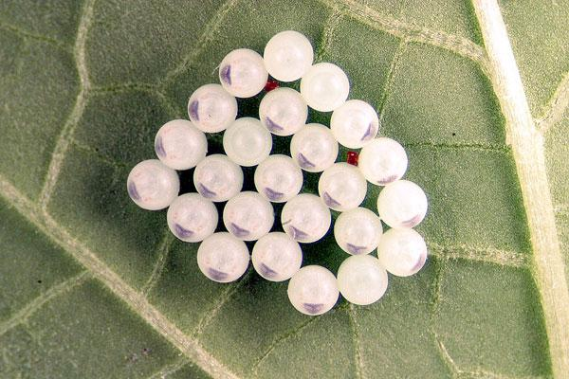
Stink bugs
Many species
Shield-shaped bodies.
Similar damage to leaf-footed bug
Eggs are barrel-shaped, usually with “spikes” around the top rim of the barrel.
Eggs are usually laid in clusters.

Slide 15
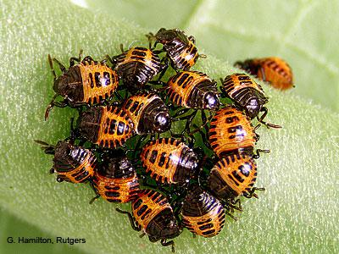
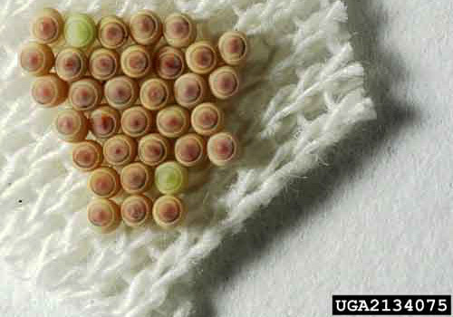
Stink bugs
As with most insects, the nymph stage looks different than the adult.

Slide 16
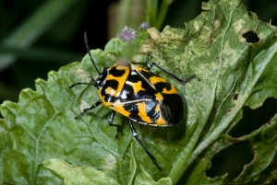
Stink bugs
Harlequin bug
Same as stink bugs

Slide 17
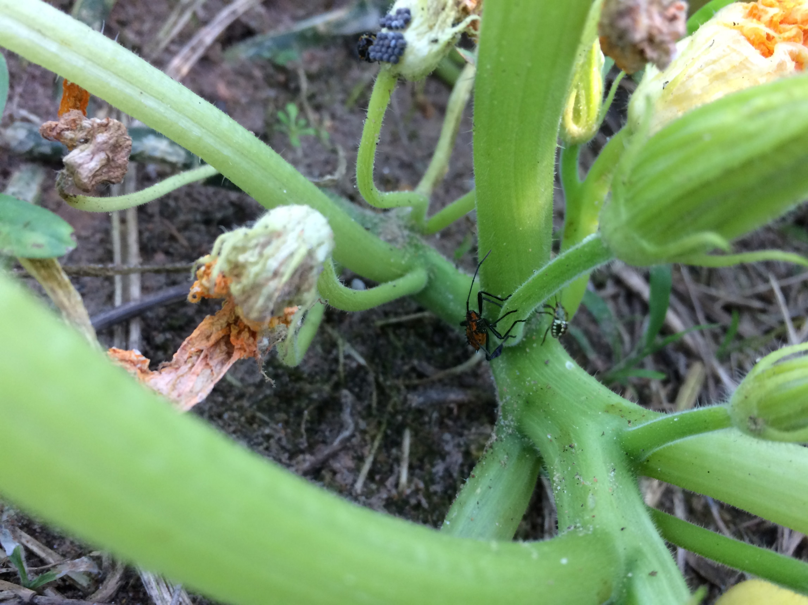

Slide 18
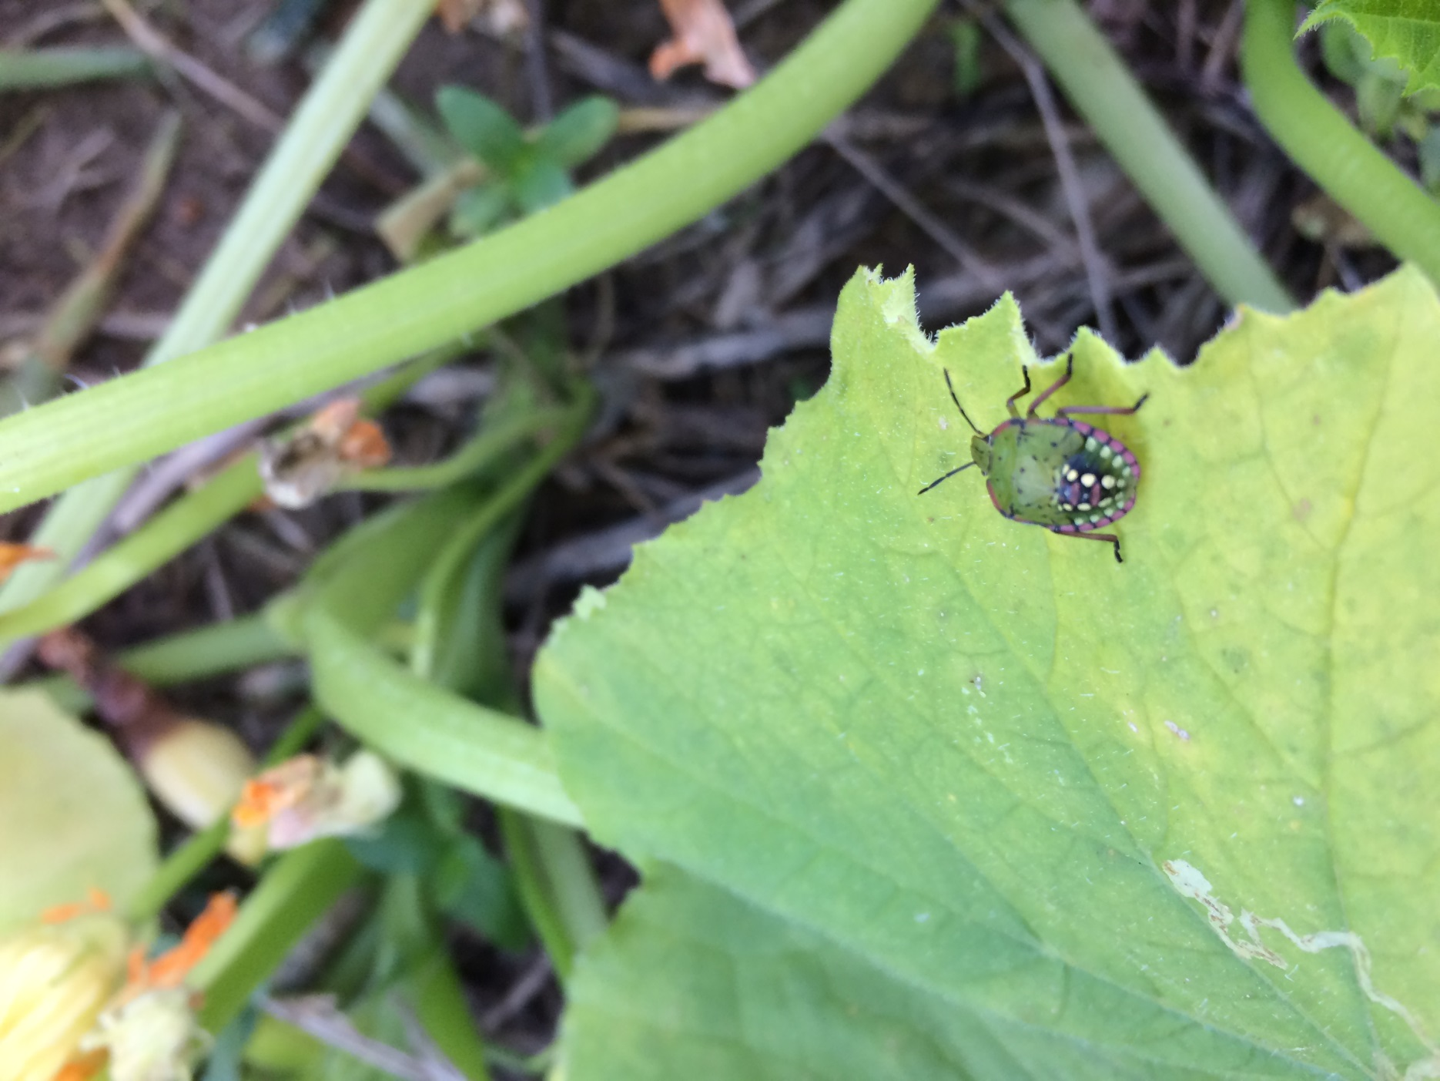

Slide 19
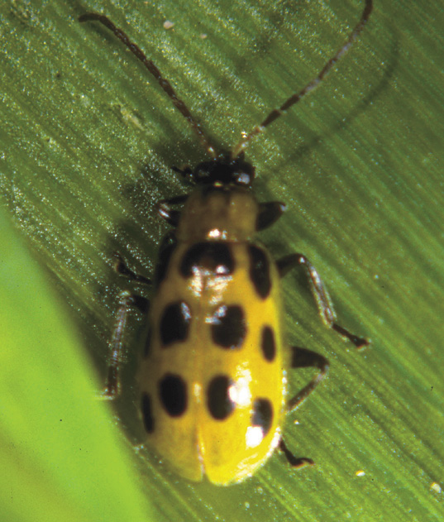
Cucumber beetle

Slide 20
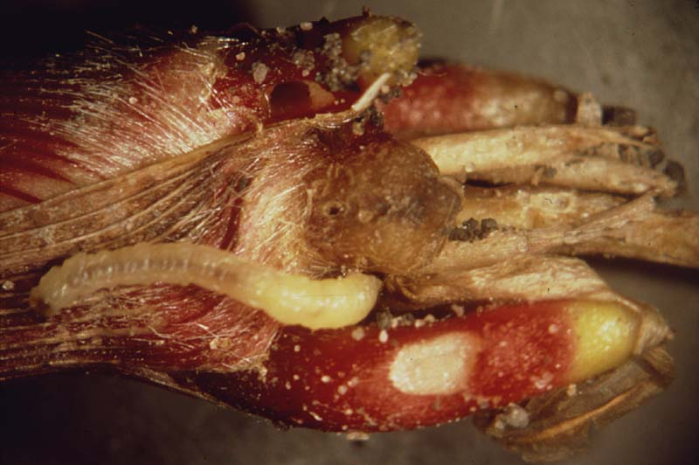
Cucumber beetle
Larval form known as Southern Corn Rootworm
Attacks roots of corn
Problems usually develop if corn is planted in the same place repeatedly.

Slide 21
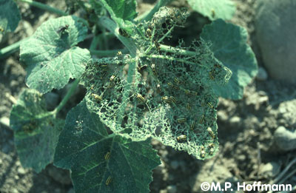
Cucumber beetle
Beetles can carry viruses and bacterial wilt
Attacks primarily cucurbits (squash, cucumber, pumpkin, etc.)

Slide 22
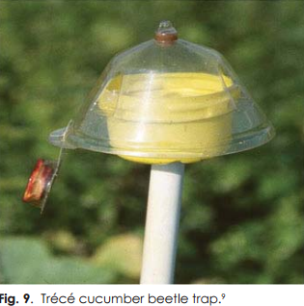
Cucumber beetle
Use trap crops of cucurbits
Plant two weeks before desired crop
Spray trap crop with insecticides
Zucchini, summer squash, and pumpkins are best
Traps and baits
Use insect pheromones or host plant chemicals to attract insects
Row covers
Plastic or organic mulches can deter egg laying and hinder movement from soil
Reflective mulches
Aluminum coated plastic mulch

Slide 23
Cucumber beetle

Slide 24
Colorado potato beetle

Slide 25
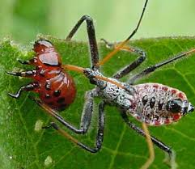
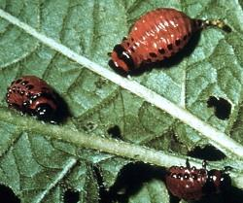
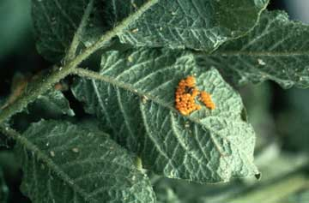
Colorado potato beetle

Slide 26
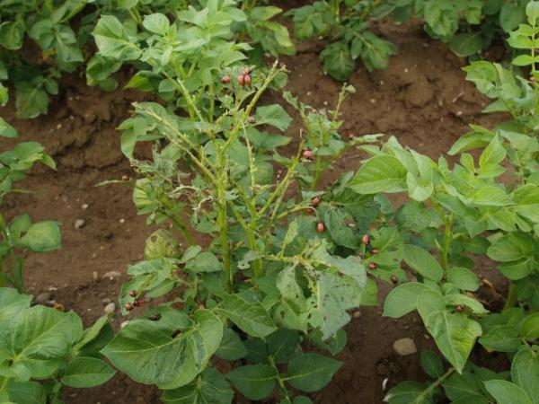
Colorado potato beetle
Adults overwinter in the soil.
Both adults and larvae feed on leaves.
Hosts include eggplant, potato, pepper, tomato
Spinosad effective on larvae
Eggplant can be used as a trap crop
Rotation is paramount
Soil tillage after harvest.

Slide 27
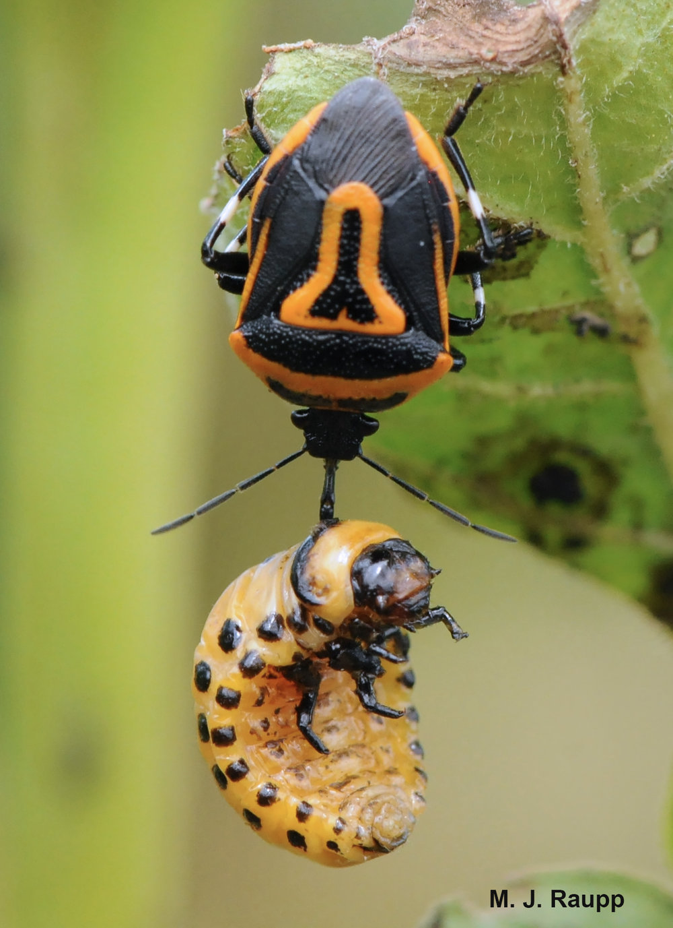
Colorado potato beetle

Slide 28
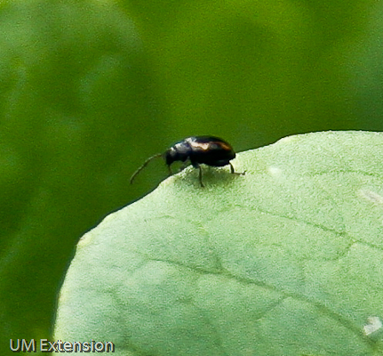
Flea beetle
Tiny insects
Chew round holes in leaves.

Slide 29
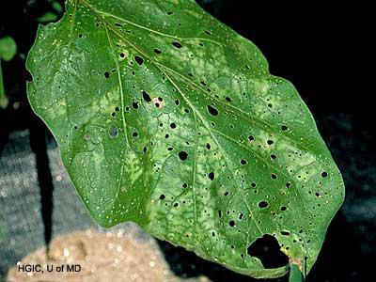
Flea beetle
.

Slide 30
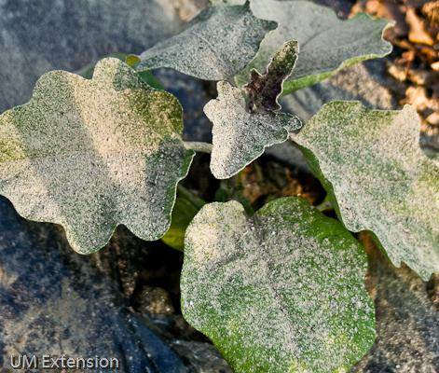
Flea beetle
Attack a wide variety of crops: eggplant tomato, potato, corn, brocolli, cabbage, cauliflower, spinach, beet, watermelon.
May transmit virus and diseases.
Eggs laid in soil.
Adults overwinter in plant debris
Populations high after mild winters.
Adults can jump away when disturbed.

Slide 31
Flea beetle
Kaolin clay
Pyrethrins, neem, spinosad
Diatomaceous earth
Wood ash
Carbaryl (sevin)
Esfenvalerate
Lambda-cyhalothrin

Slide 32
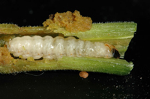
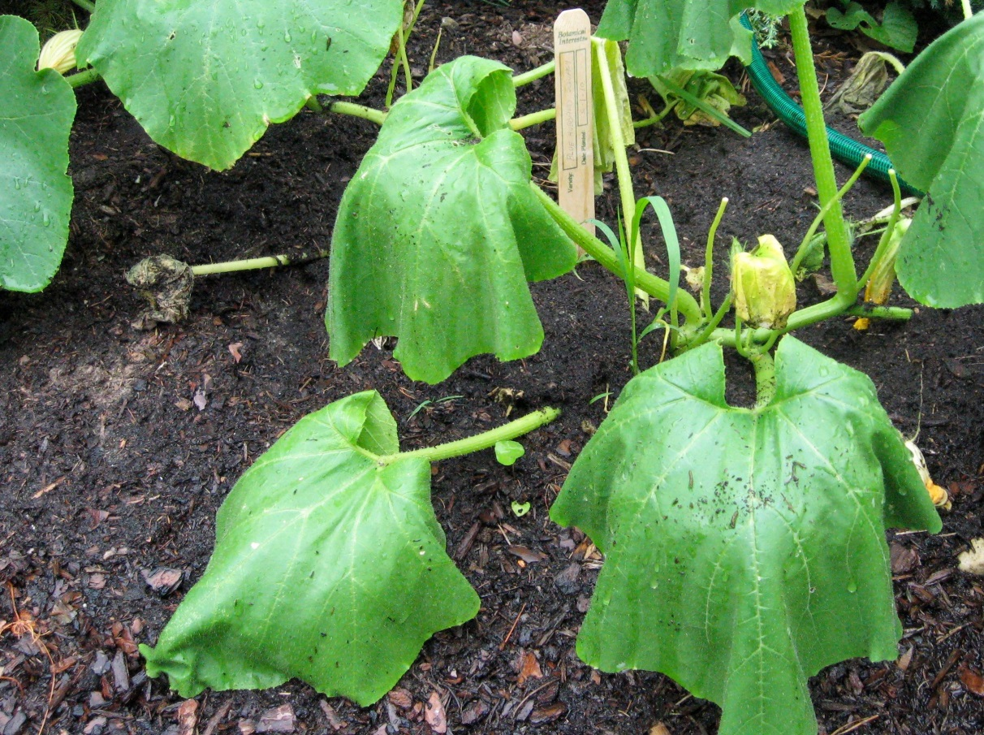
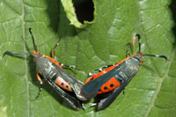
Squash vine borer

Slide 33
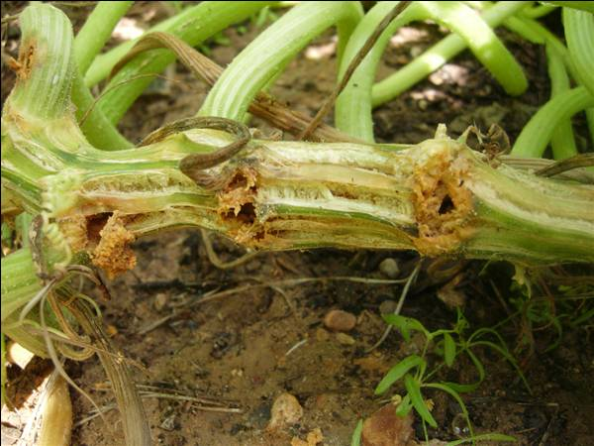
Squash vine borer

Slide 34
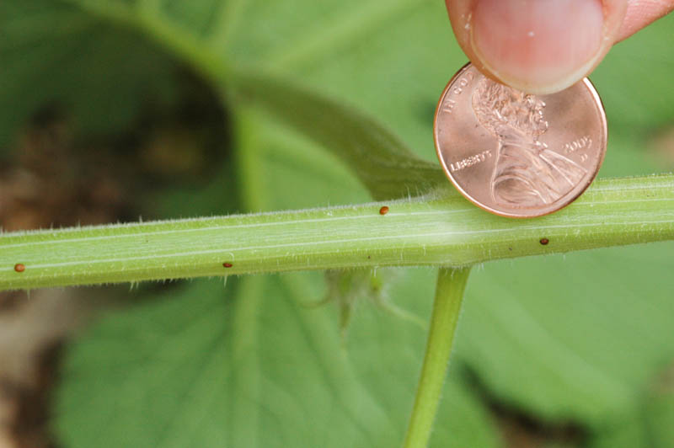
Squash vine borer
Adults emerge from cocoons in the ground late spring/summer.
Lay eggs singly at base of plant.
Adults fly during the day (odd for moths)

Slide 35
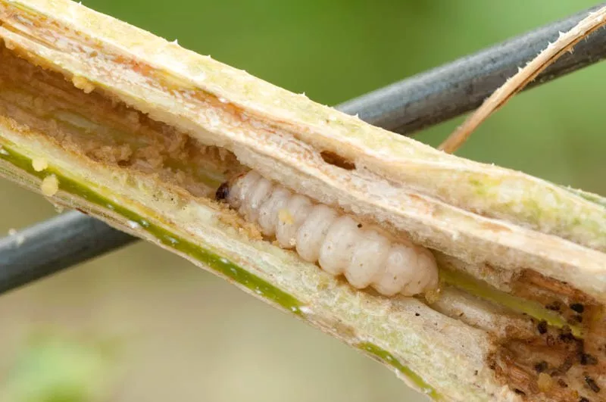
Squash vine borer
Row covers (pollination required)
Yellow sticky traps
Adults attracted to yellow (flower)
Carbaryl (sevin)
Pour some dust in a sock for light, even coverage.
Effective on moths
Short effective period
Weekly applications

Slide 36
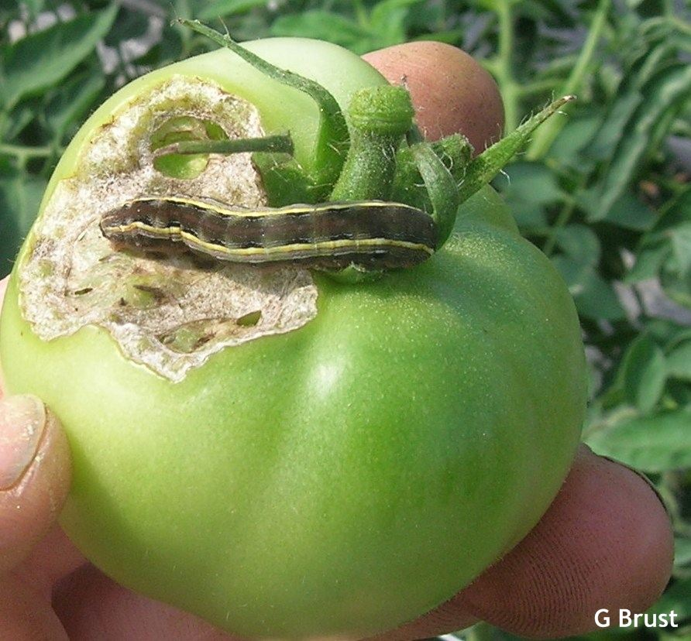
Tomato fruit worm and other worms
Will feed on leaves and fruit
Easy to control
Hand-picking
Bt pesticides

Slide 37
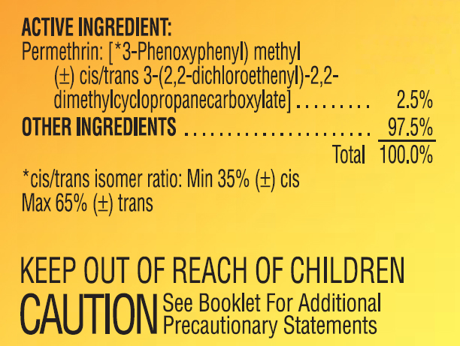
Pesticides
Whether organic or not, all have Active Ingredients labeled

Slide 38
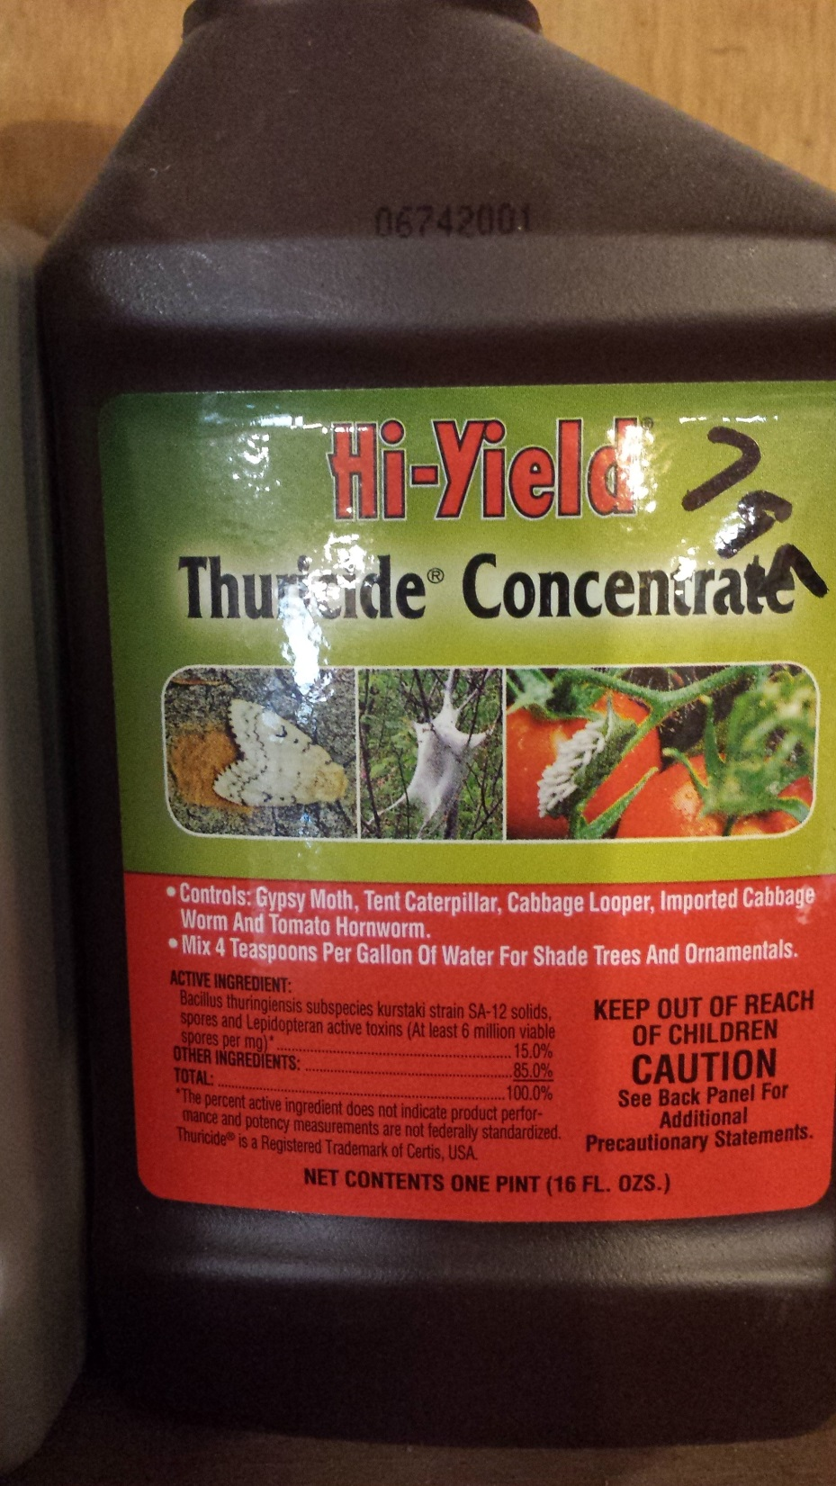

Slide 39
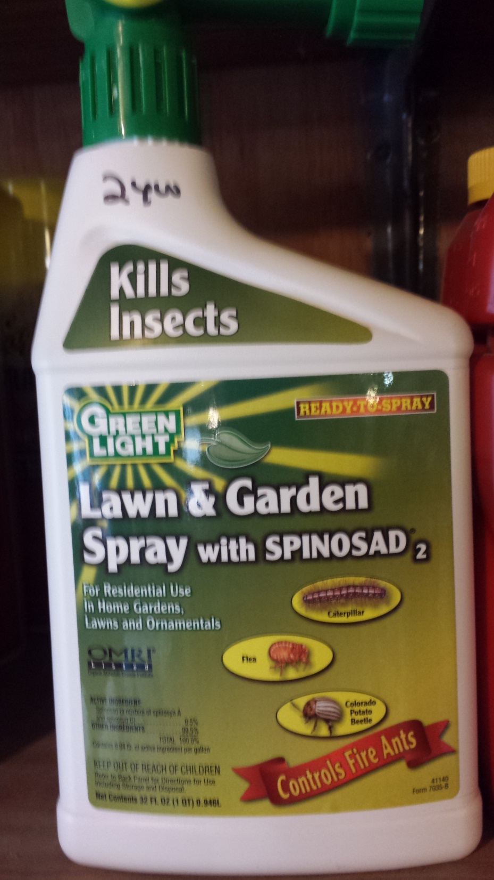

Slide 40
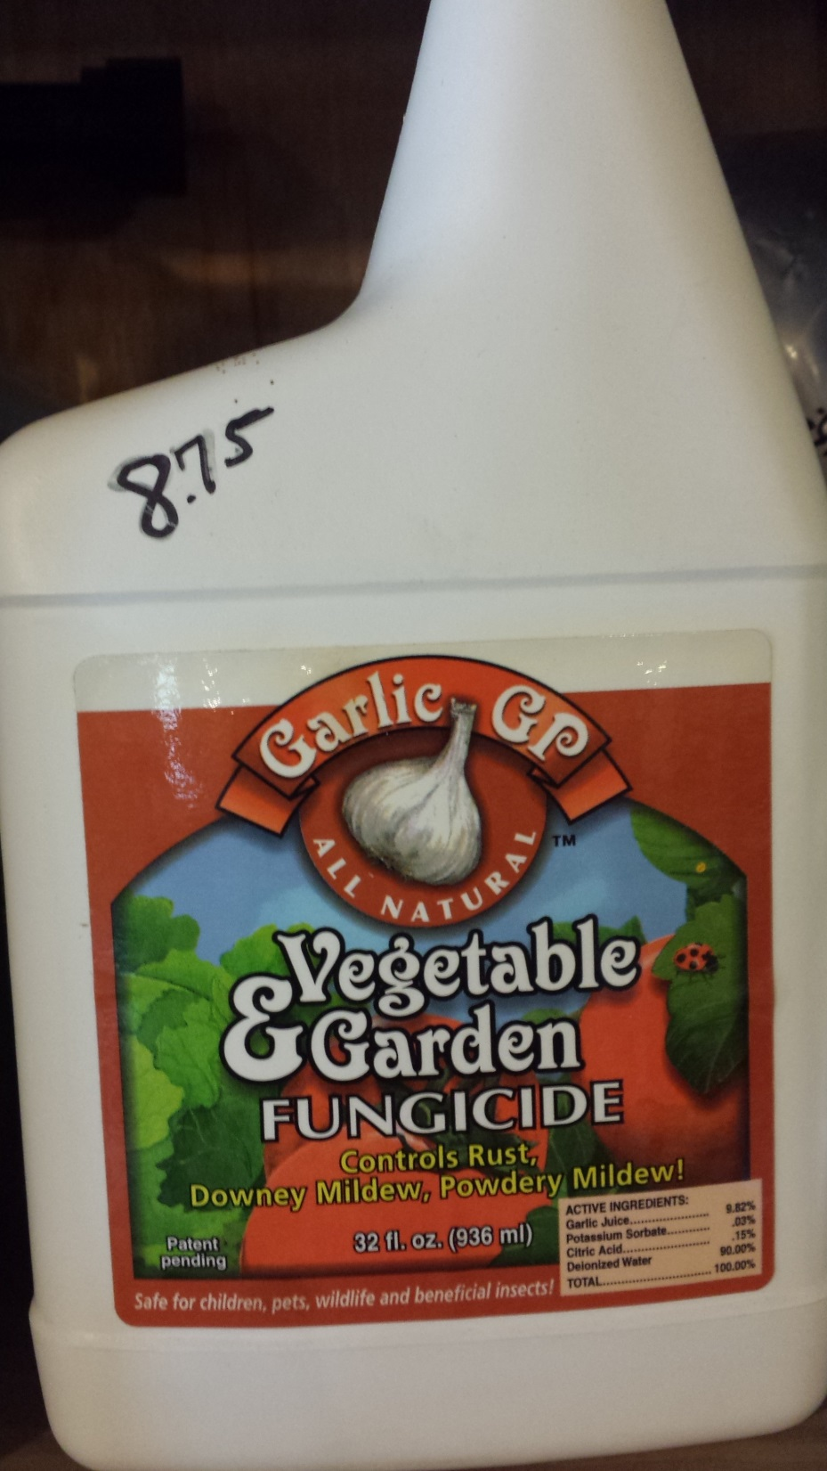

Slide 41
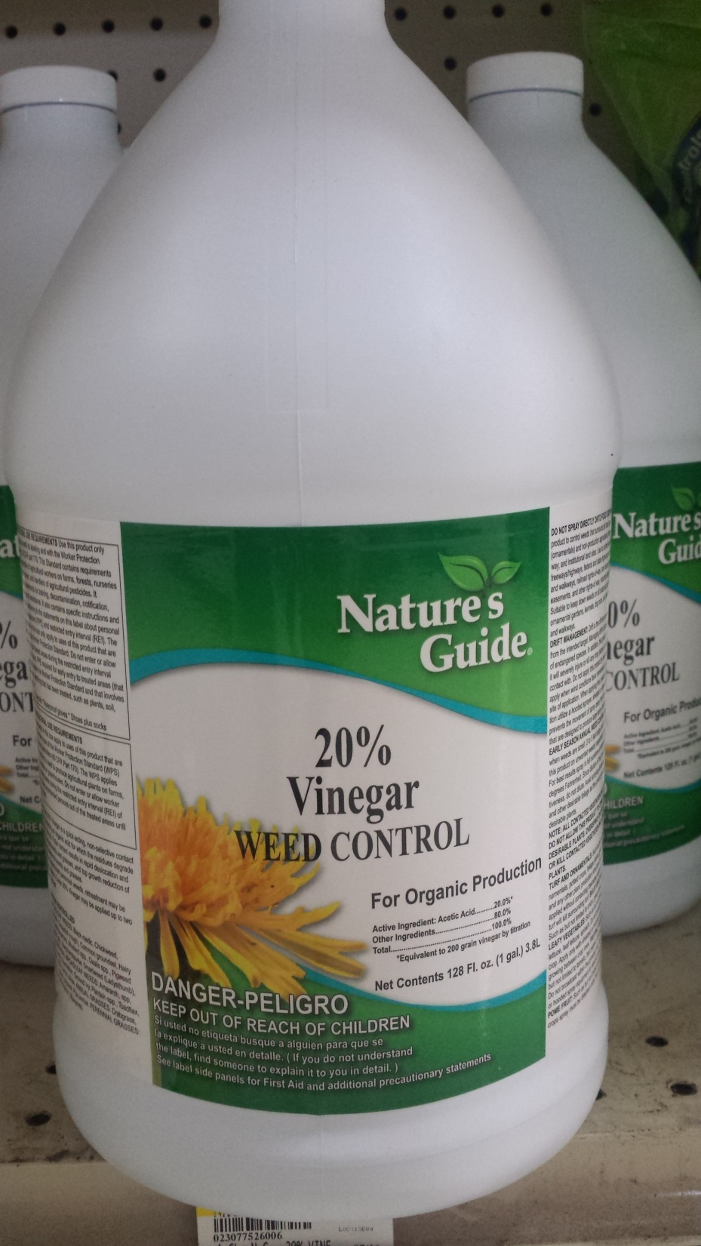
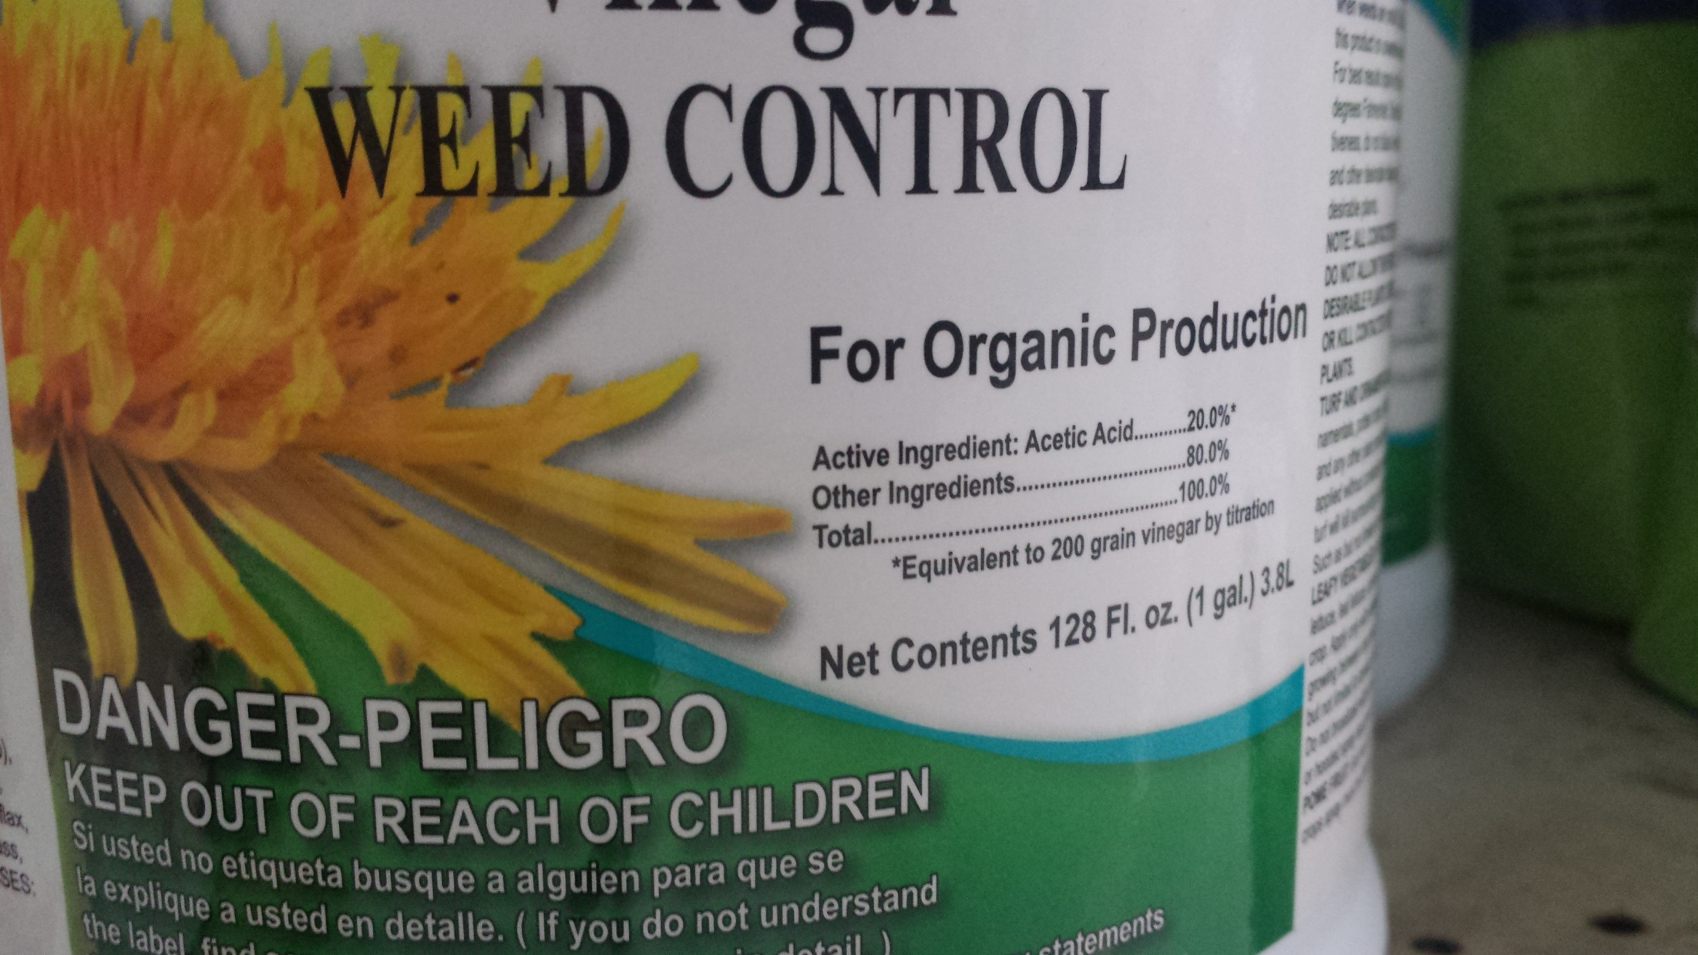

Slide 42
Active ingredients
Active ingredient concentrations are USUALLY the same across brands and products,
BUT NOT ALWAYS
Just always, always read the label.
The label has all of the information you need:
Application rate
timing,
Toxicity to humans, pets, pollinators

Slide 43
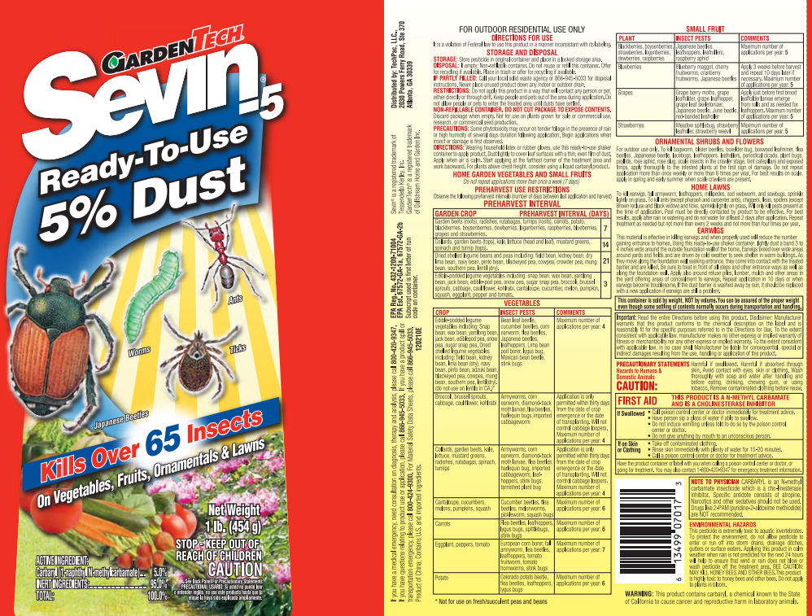
Label walk-through

Slide 48
Signal words describe acute toxicity
Caution – slightly toxic, usually irritation
Warning – moderately toxic, moderate irritation
Danger – highly toxic by at least one route of exposure
No signal word – lower toxicity than Caution.

Slide 49
Modes of Action
Pesticides are placed into categories based on their “mode of action”
Also referred to as MOA.
Insect (and weed and fungus) resistance to pesticides develops after repeated use of same pesticide or pesticides in the same MOA
Categorized by numbers
1-29
Numbers may include also A, B, C, etc designations
Just rotate numbers if repeated use necessary.
For home gardens, this is not usually a worry.

Slide 50
Trap cropping
Exactly like it sounds
Plant a more attracting crop near your “cash crop”.
Use of insecticides is less worrisome on trap crops, since you usually have no plans to harvest trap crops.
Primary examples:
Okra to attract stink bug and leaf-footed bug
Also sunflower – may also harbor beneficials. Must be planted early
Cowpeas are good attractant of stink bugs, leaf-footed bugs, and aphids

Slide 51
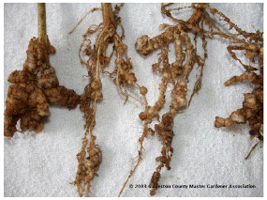
Repellant plants
Root-knot nematodes

Slide 52
Nematodes
Frequently on tomato, pepper, and okra
Prefer sandy soils
No insecticide available
(N) on tomato varieties signals resistance to nematodes
Crop rotation
Drying out soil for summer months
Soil solarization
Cultivate, level, irrigate, and cover
Clear plastic works best.
4-8 weeks, hottest part of year.

Slide 53
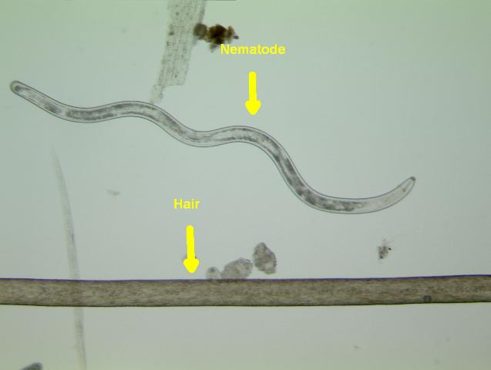
Nematodes
Stunted growth of plants
Restricts water and nutrient uptake
Organic matter (compost) additions will help
Suppressive crops
Marigolds, chrysanthemums
Elbon rye (cereal rye)
Thick (solid) plantings are most successful
Elbon rye works well as a winter cover crop, ready for planting the following spring.

Slide 54
Cover crops
Reduce erosion during off-season
Add organic matter to soil
Can add nitrogen (legumes)
Can have insect repellent properties
Encourage soil organisms and earthworms
Slow way to build organic matter on small scale
Sometimes the only way to build OM on large-scale

Slide 55
Cover crops
Summer and Winter crops
Winter:
Elbon rye
Wheat
Let leaves grow up, but mow or weedeat before seed is set.
This traps nitrogen in leaves, and slowly releases it back to soil.
Hairy vetch
Clovers
These are legumes, add nitrogen to the soil when inoculated

Slide 56
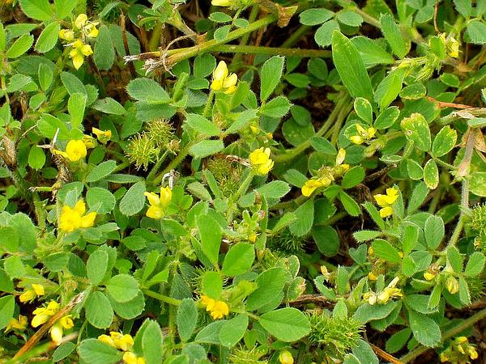
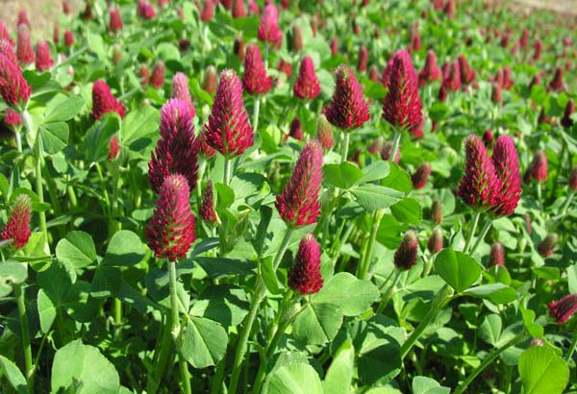
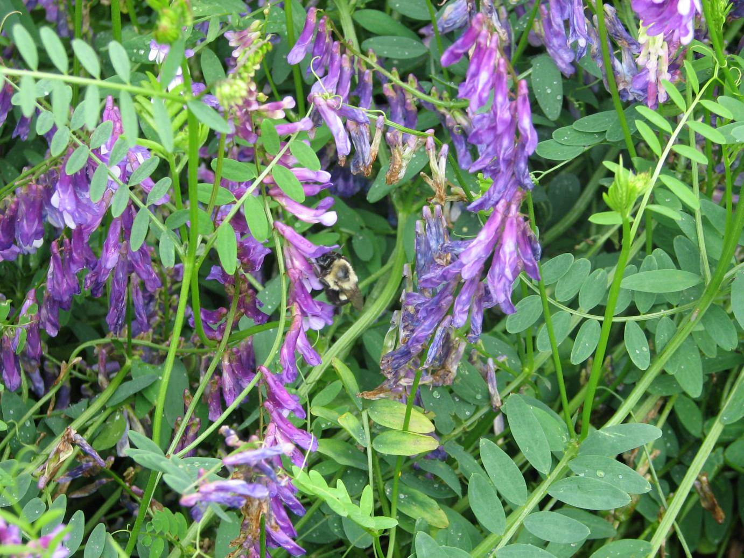
Cover crops
s

Slide 57
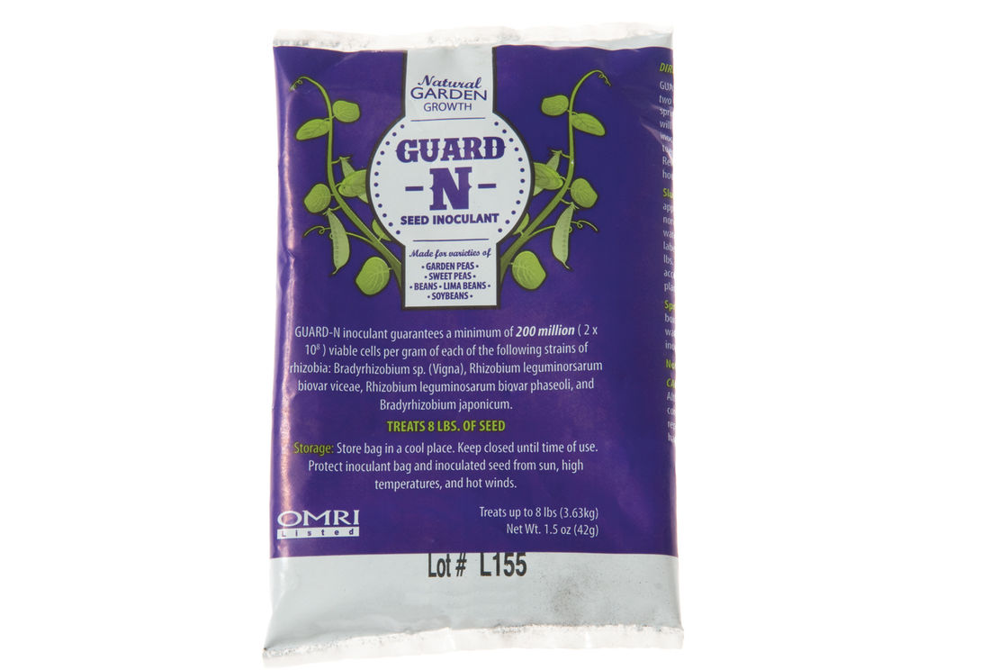
Inoculants

Slide 58
Cover crops
Rye, wheat, clovers, vetch can be allowed to reseed, if desired.
Seed set happens in March, April, May
Terminate with mowing, or herbicides
When terminated and planted into, makes a great mulch as weed barrier and soil moisture moderator.

Slide 59
Cover crops
Diversity is always best
Consider mixing species
If one species fails, another may be more competitive and succeed.

Slide 60
Attracting beneficials
Bees, ladybeetles, flies, wasps
Most adults feed on nectar
Plants most attractive have small flowers in large clusters:
Dill, fennel, parsley
Flowers in aster family (sunflower family)
Zinnias (flowers all during warm weather), coreopsis
Mustards; sweet alyssum
Coneflowers, daisies, goldenrod
Flowers blooming at different times throughout the year are best

Slide 61
Plants for beneficials
Baby’s breath
Goldenrod
Lavendar
Lemon balm
Marigolds
Nasturtiums
Purple Coneflower
Geraniums
Salvia
Sunflower
Yarrow
Black-eyed susan
Chamomile
Cilantro
Cosmos
Daisies

Slide 62
Attract beneficials
Encourage birds, spiders, lizards

Slide 66
Assassin bug vs leaf-footed bug
Hard to tell the difference
Leaf-footed nymphs will stay grouped together to overcome plant defenses
Assassin bug nymphs usually solitary.
Assassin bugs carry proboscis forward
Leaf-footed bugs carry proboscis underneath body.
Assassin bugs will bite humans
Assassin bug will rare-up on hind legs when threatened
Look around for other assassins feeding on insects

Slide 67
Plant Diseases
Plant diseases are tough
Can be fungal, bacteria, virus, or others (less common)
Usually no CURE for disease
Prevention is best.
Sometimes can stop disease from spreading
Products can protect plants from spread
Three factors necessary for disease development
Presence of pathogen
Availability of susceptible host
Favorable environmental conditions

